Slide 1
FORMAL LANGUAGE & AUTOMATA THEORY
By: Computer Engineering
SIET Nilokheri

Slide 2
Concept of AUTOMATA
Automata is an abstract model of digital computer with discrete input and output.
The term “Automata” is derived from the word “Αutomation” which means automatically or self acting.
Automata is a theoretical branch of computer science and mathematical which deal with the behaviour of automatic machine. It is the study of abstract machines and the computation problems that can be solved using these machine. The abstract machine is called the Automata.
An Automata with a finite number of state is called a Finite Automata or finite state machine.
This Automata consists of states and transitions. The state is represented by circles, and the Transitions is represented by arrows.
ABSTRACT MACHINE
The abstract machine is a model of a computer system constructed to allow a detailed and precise analysis of how the computer system works.

Slide 3
Cont…
Automatic consist of input, output and stages.
Input: That are finite number of fixed value from alphabet.
Output: Which provide a corresponding output result on processing given input.
States: Which are different configuration of automatic.
Fig: Automatic Machine

Slide 4
TYPE OF AUTOMATA
There are two type of automata that is recognizers and transducers.
Recognizers: These are the automatic machine that are used to recognize the given input. It provide the output yes if it can recognize the string, otherwise output is no if it can’t.
Transducers: These are the machine that takes some input and while processing the input it transduces some new output.

Slide 5
finite automata
Finite automata is an automatic machine with finite number of states. Finite automata is used to describe the regular language. It is a good model for computer with the small memory.
A finite automata is a quintuple
M = (Q, Σ, 𝛿, q0or F)
where
Q: Is a non-empty finite set of states presents in the finite control. (q0,q1,q3,…..,qn).
Σ: Is a non-empty finite set of input symbols which can be passed to the finite state machine. (a, b, c,0,1, ..)
q0: Is a starting state, one of the state in Q.
F: Is a non-empty set of final states or states, set of final states belongs to Q.
𝛿 : Is a function called transition function that takes two arguments a state and a input symbol, it single state.

Slide 6
Working of finite automata
Finite Automata are used recognize pattern. It takes the string of symbols as input and changes it’s state accordingly. When the desired symbols is found then the transition occurs. At the time of transition the automata can either move to the next state or stay in the same state.
Finite automata have two states accept state or reject states. When the input string is processed successfully and the automata reached it’s final state when it’s accepts .
Finite automata consist of:
Input Tape:- it is linear tape having same number of cells each input symbol is placed in each cell.
Finite Control :- the finite control decides the next state on receiving particular input from input tape the tape reader read the cell one by one from left to right and at a time only one input symbol is read.
Read Only Head: Only read the input from input type ( left to right direction ).

Slide 7
Cont…
Input tape
EE | BB | C | D | EE | RR | B | B | AA | DD
Read Only Head
Finite control
Fig: Working of Finite Automata

Slide 8
TERMINOLOGY

Slide 9
Cont…

Slide 10
Representation of Finite automata
The finite automata can be representation in three ways as given below –
Graphical (Transition diagram)
Tabular (Transition table)
Mathematical (Transition Function)

Slide 11
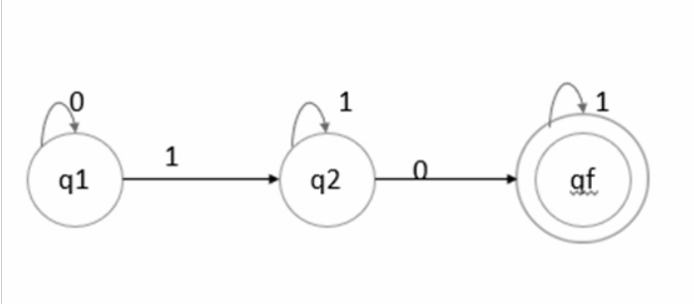
Transition diagram
It is basically a graphical representation of a state & a symbol.

Slide 12
Transition TABLE
It is basically a tabular representation of the transition function that takes two arguments (a state & a symbol) and returns a value (the ‘next state’).
δ : Q × Σ → Q
State / input symbols | 0 | 1
->q1 | q1 | q2
q2 | qf | q2
qf | - | qf

Slide 13
Transition function
The transition function is denoted by δ. The two parameters mentioned below are the passes to this transition function.
Current state
Input symbol
The transition function returns a state which can be called as the next state.
δ (current_state, current_input_symbol) = next_state
For example, δ(q0,a)=q1

Slide 14
Type of Finite automata
There are two type of finite automata:
Deterministic Finite Automata.
Non-Deterministic Finite Automata.

Slide 15
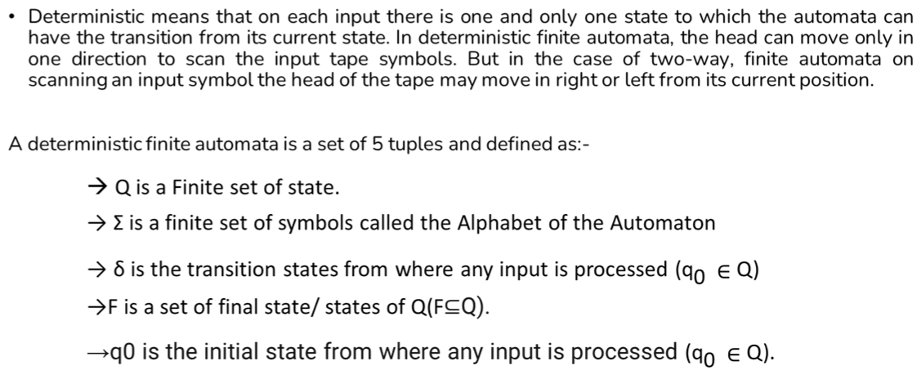
Deterministic Finite Automata

Slide 16
Cont…
Example :-Construct DFA which accepts all the string over alphabets Σ = {0,1} start with 0.
Solution:- L = {0,01,00,010,011,000,001,…………………………………}
Transition Diagram:-
0 0,1
1 0,1
Transition Table:-
q₀
q₁
q₂
States/input | 0 | 1
->q0 | q1 | q2
q1 | q1 | q1
q2 | q2 | q2

Slide 17
non-Deterministic Finite Automata
For each state there can be zero, one, two, or more transitions corresponding to a particular symbol. If NFA gets to a state with more than one possible transition corresponding to the input symbol, we say it branches. If NFA gets to a state where there is no valid transition, then that branch dies An NFA accepts the input string if there exists some choice of transitions that leads to ending in an accept state.
NFA is 5-tuple (Q, ∑, q₀ , T, δ) whereas before
Q is finite set of states
∑ is alphabet of input symbols
q₀ is start state
T is subset of Q giving the accept states
δ is the transition function.
Now the transition function specifies a set of states rather than a state: it maps Q☓ ∑ to {subsets of Q}

Slide 18
Cont…

Slide 19
Difference between DFA & nFA

Slide 20
Finite Automata with Epsilon (€) Transitions
The automaton may be allowed to change its state without reading the input symbol 2.
In diagrams, such transitions are depicted by labeling the appropriate arcs with ε.
Note that this does not mean that E has become an input symbol. On the contrary, we assume that the symbol E does not belong to any alphabet.
ε -NFAs add a convenient feature but (in a sense) they bring us nothing new. They do not extend the class of languages that can be represented.
Both NFAs and E-NFAs recognize exactly the same languages.

Slide 21
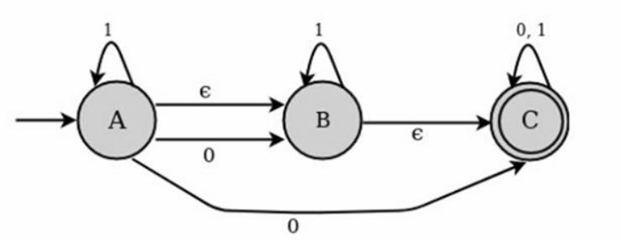
Cont…

Slide 22
Cont…
For the above example, ε closure are as follows −
E closure( A) : {A, B,C}
E closure( B) :{B,C}
E closure( C) : {C}
Transitions Table
State | 0 | 1 | Epsilon
A | B,C | A | B
B | - | B | C
C | C | C | -

Slide 23
Conversion from NFA to DFA
Suppose there is an NFA machine M = { Q, ∑, q0, δ, F }which recognizes a language L. Then the DFA machine M’= { Q’, ∑, q0, δ’, F’} can be constructed for language L as:
Initially Q’ = ɸ.
Add q0 to Q’.
For each state in Q’, find the possible set of states for each input symbol using transition function of NFA. If this set of states is not in Q’, add it to Q’.
Final state of DFA will be all states with contain F (final states of NFA)

Slide 24
Example
Consider the following NFA shown in Figure.
Solution :
Following are the various parameters for NFA. Q = { q0, q1, q2 } ∑ = ( a, b ) F = { q2 } δ (Transition Function of NFA)

Slide 25
Cont…
STATES | a | b
-> q0 | q0,q1 | q0
q1 |  | q2
q2
Step 1: Q’ = ɸ Step 2: Q’ = {q0} Step 3: For each state in Q’, find the states for each input symbol . Currently, state in Q’ is q0, find moves from q0 on input symbol a and b using transition function of NFA and update the transition table of DFA. Step 4: δ’ (Transition Function of DFA).

Slide 26
Cont…
STATES | a | b
q0 | { q0,q1} | q0
Now { q0, q1 } will be considered as a single state. As its entry is not in Q’, add it to Q’. So Q’ = { q0, { q0, q1 } }
Now, moves from state { q0, q1 } on different input symbols are not present in transition table of DFA, we will calculate it like: δ’ ( { q0, q1 }, a ) = δ ( q0, a ) ∪ δ ( q1, a ) = { q0, q1 } δ’ ( { q0, q1 }, b ) = δ ( q0, b ) ∪ δ ( q1, b ) = { q0, q2 } Now we will update the transition table of DFA.
δ’ (Transition Function of DFA)

Slide 27
Cont…
STATES | a | b
q0 | { q0,q1} | q0
{ q0,q1} | { q0,q1} | { q0,q2}
Now { q0, q2 } will be considered as a single state. As its entry is not in Q’, add it to Q’. So Q’ = { q0, { q0, q1 }, { q0, q2 } }
Now, moves from state {q0, q2} on different input symbols are not present in transition table of DFA, we will calculate it like: δ’ ( { q0, q2 }, a ) = δ ( q0, a ) ∪ δ ( q2, a ) = { q0, q1 } δ’ ( { q0, q2 }, b ) = δ ( q0, b ) ∪ δ ( q2, b ) = { q0 } Now we will update the transition table of DFA.
δ’ (Transition Function of DFA)

Slide 28
Cont…
STATES | a | b
-> q0 | { q0,q1} | q0
{ q0,q1} | { q0,q1} | { q0,q2}
{ q0,q2} | { q0,q1} | q0
As there is no new state generated, we are done with the conversion. Final state of DFA will be state which has q2 as its component i.e., { q0, q2 }
Following are the various parameters for DFA. Q’ = { q0, { q0, q1 }, { q0, q2 } } ∑ = ( a, b ) F = { { q0, q2 } } and transition function δ’ as shown above. The final DFA for above NFA has been shown in Figure.

Slide 29
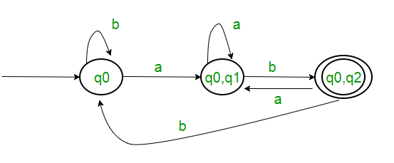
Cont…
Transition Diagram:

Slide 30
Applications of finite automata
For the designing of lexical analysis of a complier.
For recognizing the pattern using regular expressions.
For the designing of the combination and sequential circuits using Mealy and Moore machine.
Used in text editors.
For the implementation of spell checkers.

Slide 31
Limitations of finite automata
Finite automata can only count finite input.
There is no finite auto ma that can find and recognize set of binary string of equal 0s & 1s.
Set of strings over "(" and ")" & have balanced parenthesis.
Input tape is read only and only memory it has is, state to state.
It can have only string pattern.
Head movement is in only one direction.

Slide 32
MINIMIZATION OF DFA’s
Any DFA defines a unique language, but the converse is not true. For a given language, there may be many DFA's that accepts it. To under stand the minimization first of all one should be very clear about the dead state, inaccessible states and indistinguishable states, so let us discuss them first.
Dead States: All those non final states which transit to itself for all input symbols in Σ, are called Dead state.
Inaccessible States: All those states which can never be reached from initial state are called inaccessible states.
There are following methods for minimization of DFA:
Hit & Trial Method
Partition Method
Myhill- Nerode theorem

Slide 33
Hit & Trial Method
Step 1: Remove all the states that are unreachable from the initial state via any set of the transition of DFA.
Step 2: Draw the transition table for all pair of states.
Step 3: Now split the transition table into two tables T1 and T2. T1 contains all final states, and T2 contains non-final states.
Step 4: Find similar rows from T1 such that:
1. δ (q, a) = p
2. δ (r, a) = p
That means, find the two states which have the same value of a and b and remove one of them.
Step 5: Repeat step 3 until we find no similar rows available in the transition table T1.
Step 6: Repeat step 3 and step 4 for table T2 also.
Step 7: Now combine the reduced T1 and T2 tables. The combined transition table is the transition table of minimized DFA.

Slide 34
Partition Method using Equivalence Theorem
If X and Y are two states in a DFA, we can combine these two states into {X, Y} if they are not distinguishable. Two states are distinguishable, if there is at least one string S, such that one of δ (X, S) and δ (Y, S) is accepting and another is not accepting. Hence, a DFA is minimal if and only if all the states are distinguishable.
Step 1 − All the states Q are divided in two partitions − final states and non-final states and are denoted by P₀. All the states in a partition are 0th equivalent. Take a counter k and initialize it with 0.
Step 2 − Increment k by 1. For each partition in P_{k}, divide the states in P_{k} into two partitions if they are k-distinguishable. Two states within this partition X and Y are k-distinguishable if there is an input S such that δ(X, S) and δ(Y, S) are (k-1)-distinguishable.
Step 3 − If P_{k} ≠ P_{k-1}, repeat Step 2, otherwise go to Step 4.
Step 4 − Combine k^{th} equivalent sets and make them the new states of the reduced DFA.

Slide 35
Myhill- Nerode theorem
Step 1 − Draw a table for all pairs of states (Q_{i}, Q_{j}) not necessarily connected directly [All are unmarked initially]
Step 2 − Consider every state pair (Q_{i}, Q_{j}) in the DFA where Q_{i} ∈ F and Q_{j} ∉ F or vice versa and mark them. [Here F is the set of final states]
Step 3 − Repeat this step until we cannot mark anymore states −
If there is an unmarked pair (Q_{i}, Q_{j}), mark it if the pair {δ (Q_{i}, A), δ (Q_{i}, A)} is marked for some input alphabet.
Step 4 − Combine all the unmarked pair (Q_{i}, Q_{j}) and make them a single state in the reduced DFA.

Slide 36
Regular Expression
A regular expression can be defined as a language or string accepted by a finite automata.
We know that a finite automata consists of five tuples {Q, Σ, δ, q₀, F}. Among them a Regular Expression is a string on Σ, i.e. it will consist only with input alphabets.
Regular expressions are used to match character combinations in strings. String searching algorithm used this pattern to find the operations on a string.
Regular language can be easily described by simple expression is known as regular expression.
Finite automata used to recognise the pattern of string but regular expression are used to generate pattern of string.
Regular expression is an algebraic formula whose value is a pattern consisting of a set of string called the language of expression.

Slide 37
Definition of Regular Expression
The set of regular expression is defined by the following rules:
1. Every letter of Σ can be made into a regular expression, null string. E itself is a regular expression.
2. If r, and r₂ are regular expression, then
(r1)
r1r2
r,+r₂
r1*
r1+ are also regular expression.
3. Nothing else is regular expression.

Slide 38
Operations On Regular Language
Union: If L and M are two regular languages then their union L U M is also a union.
L U M = {s | s is in L or s is in M}
Intersection: If L and M are two regular languages then their intersection is also an intersection.
L ⋂ M = {st | s is in L and t is in M}
Kleen closure: If L is a regular language then its Kleen closure L1* will also be a regular language.
L* = Zero or more occurrence of language L.

Slide 39
Example For Regular Expressions
Example 1: Write the regular expression for the language accepting all combinations of a's, over the set ∑ = {a}
Solution:
All combinations of a's means a may be zero, single, double and so on. If a is appearing zero times, that means a null string. That is we expect the set of {ε, a, aa, aaa, ....}. So we give a regular expression for this as:
R = a*
That is Kleen closure of a.

Slide 40
Example For Regular Expressions
Example 2:Write the regular expression for the language accepting all combinations of a's except the null string, over the set ∑ = {a}
Solution:
The regular expression has to be built for the language .
L = {a, aa, aaa, ....}
This set indicates that there is no null string. So we can denote regular expression as:
R = a⁺

Slide 41
Algebraic Laws for Regular Expressions
1. Associativity Laws A + (B + C) = (A + B) + C A.(B.C) = (A.B).C.
2. Commutativity Law A + B = B + A.
3. Identity Laws ∅ + A = A + ∅ = A ε.A = A.ε = A
4. Distributivity Laws
Left distributivity: A.(B + C) = A.B + A.C.
Right distributivity: (B + C).A = B.A + C.A.

Slide 42
Cont…
5. Closure Laws (A*)* = A*, ∅* = ε, ε* = ε, A+ = AA* = A*A, and A* = A + + ε.
6. De Morgan Type Law (L + B)* = (L*B*)*
7. Idempotent Law A + A = A.

Slide 43
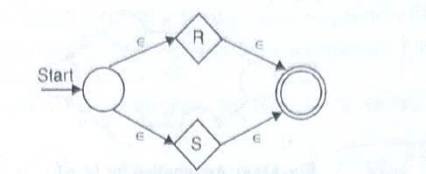
Construction of fa for regular expression
We can construct NFA with e transmission by considering following four facts.
1. The expression is r+s for some smaller expression rand s. The following automation serves, where R is automation for r and S is automation for s. That is, starting at the new start state, we can go to the start state of either the automation for r or the automation for S. We can reach the accepting state of one of these automata, following a path labelled by some string in L(r) and L(s), respectively. Once we reach the accepting state of the automation for r or s, we can follow one of the E-arcs to the accepting state of the new automation. The language for the automation in Fig. is L(r) L(s).

Slide 44
Cont…
2. The expression rs for some smaller expression r and s. The automation for the concatenation is show in Fig.
3. The expression is for some smaller expression r. Then we use automation of Fig. That automation allow us to go either:

Slide 45
Cont…
(i) Directly from the start state to the accepting state along a path labelled E.
(ii) To the start state of automation for r, through that automation one or more times, and then to accepting state. This set of paths allow us to accept strings in L(r), L(r), L(r), L(r), L(r), L(r), and so on, thus covering all strings in L(r*) except perhaps Є which was covered by the direct arc to the accepting state. where R is automation for r.
4. The expression is (r) for the smaller expression r. The automation for r also serves as the automation for (r), since the parentheses do not change the language defined by the expression.

Slide 46
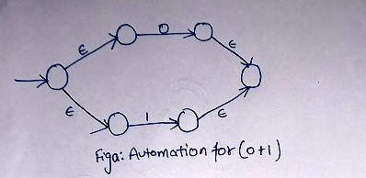
Example
Construct the ε-NFA for the regular expression (0+1)*1(0+1).
Solution: Here automation for 0 and 1 is basic automation. First we will make automation for (0+1) as in Fig (a).

Slide 47
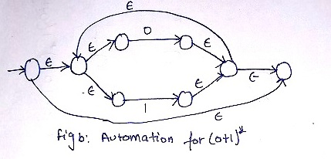
Cont…
Now we will construct it into automation for (0+1)* as shown in Fig. b.
Now we will construct for automation for 1. (0+1) as shown in Fig. c.

Slide 48
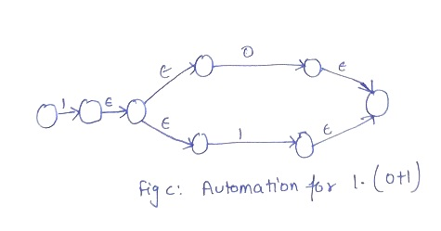
Cont…
Now we have to connect E-NFA of Fig. b and E-NFA of Fig. c by a E-transition to find out the E-NFA for given regular expression as shown in Fig. d.

Slide 49
Cont…

Slide 50
Construction of regular expression from Dfa
ARDENS'S THEOREM:
Let P and Q be two regular expression over alphabet 2. If P does not contains string E, then R = Q+RP has a unique solution that is R = QP* . It can be understand as : R = Q + RP
Put the value of R in R.H.S. R=Q+(Q+RP)PQ+QP+ Rp2
When we put the value of R again and again we got the following equation. R = Q+QP + QP² + QP³ ……... R = Q(1+P+P²+P³ +…….)
R = Q(€ +P+P²+P³+…….)
R = QP*

Slide 51
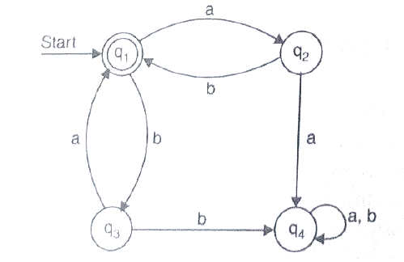
Example
Find the regular expression for transition diagram given in Fig.
Solution: Now let us from the equations q₁= q₂b + q₃a + € q₂= q₁a q₃= q₁b q₄= q₂a + q₃b + q₄a + q₄b
Put q₂ & q₃ in q₁ as
q₁= q₁ab + q₁ba + € q₁ = € + q₁ (ab + ba) q₁= € (ab + ba)*
So required regular expression is (ab+ba)*.

Slide 52
THANK YOU…

